Slide 1


Bringing the best of the Web to your .NET apps
Palak Goel
Program Manager
February 2021

Slide 2

Agenda
WebView2 is GA 🎉
WebView2 Case Studies
Getting Started with WebView2
Roadmap

Slide 3
Hybrid Approach
Web
Native

Slide 4
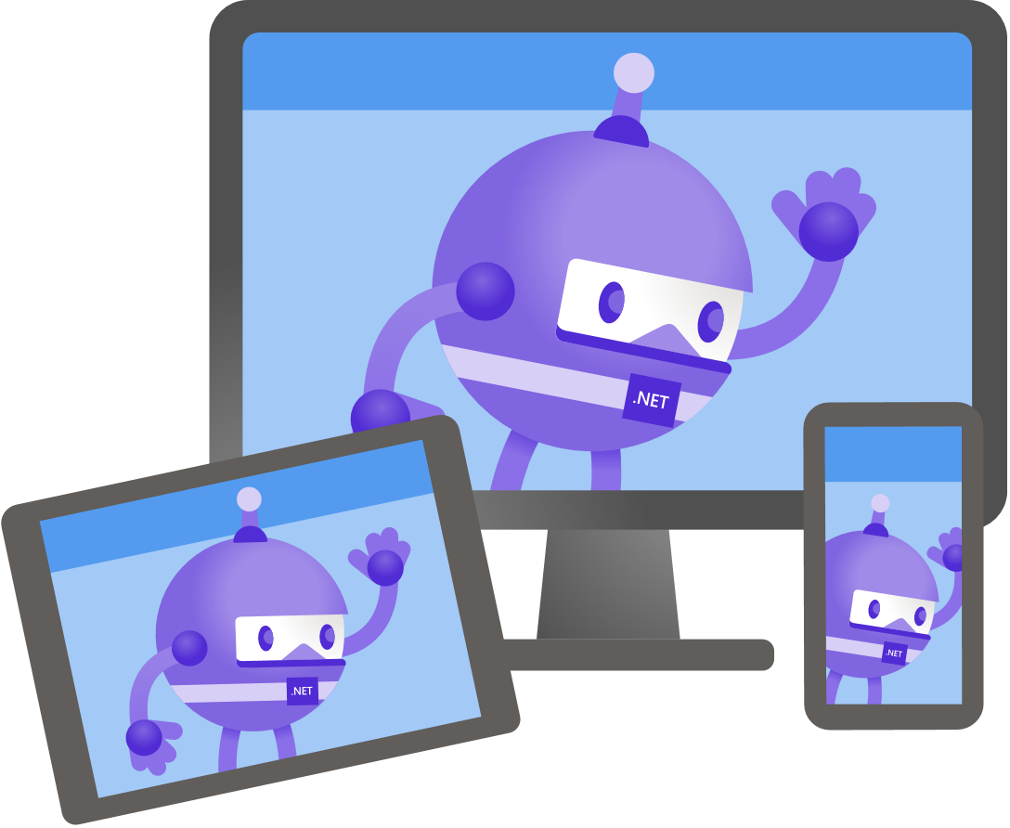
Hybrid Approach
Web
Code Sharing
Web Ecosystem
Rapid Deployment

Slide 5

Hybrid Approach
Native
Advanced Windowing
Access to DRM
File Picker

Slide 6

Hybrid Approach
Web
Native
Code Sharing
Web Ecosystem
Rapid Deployment
Advanced Windowing
Access to DRM
File Picker

Slide 7
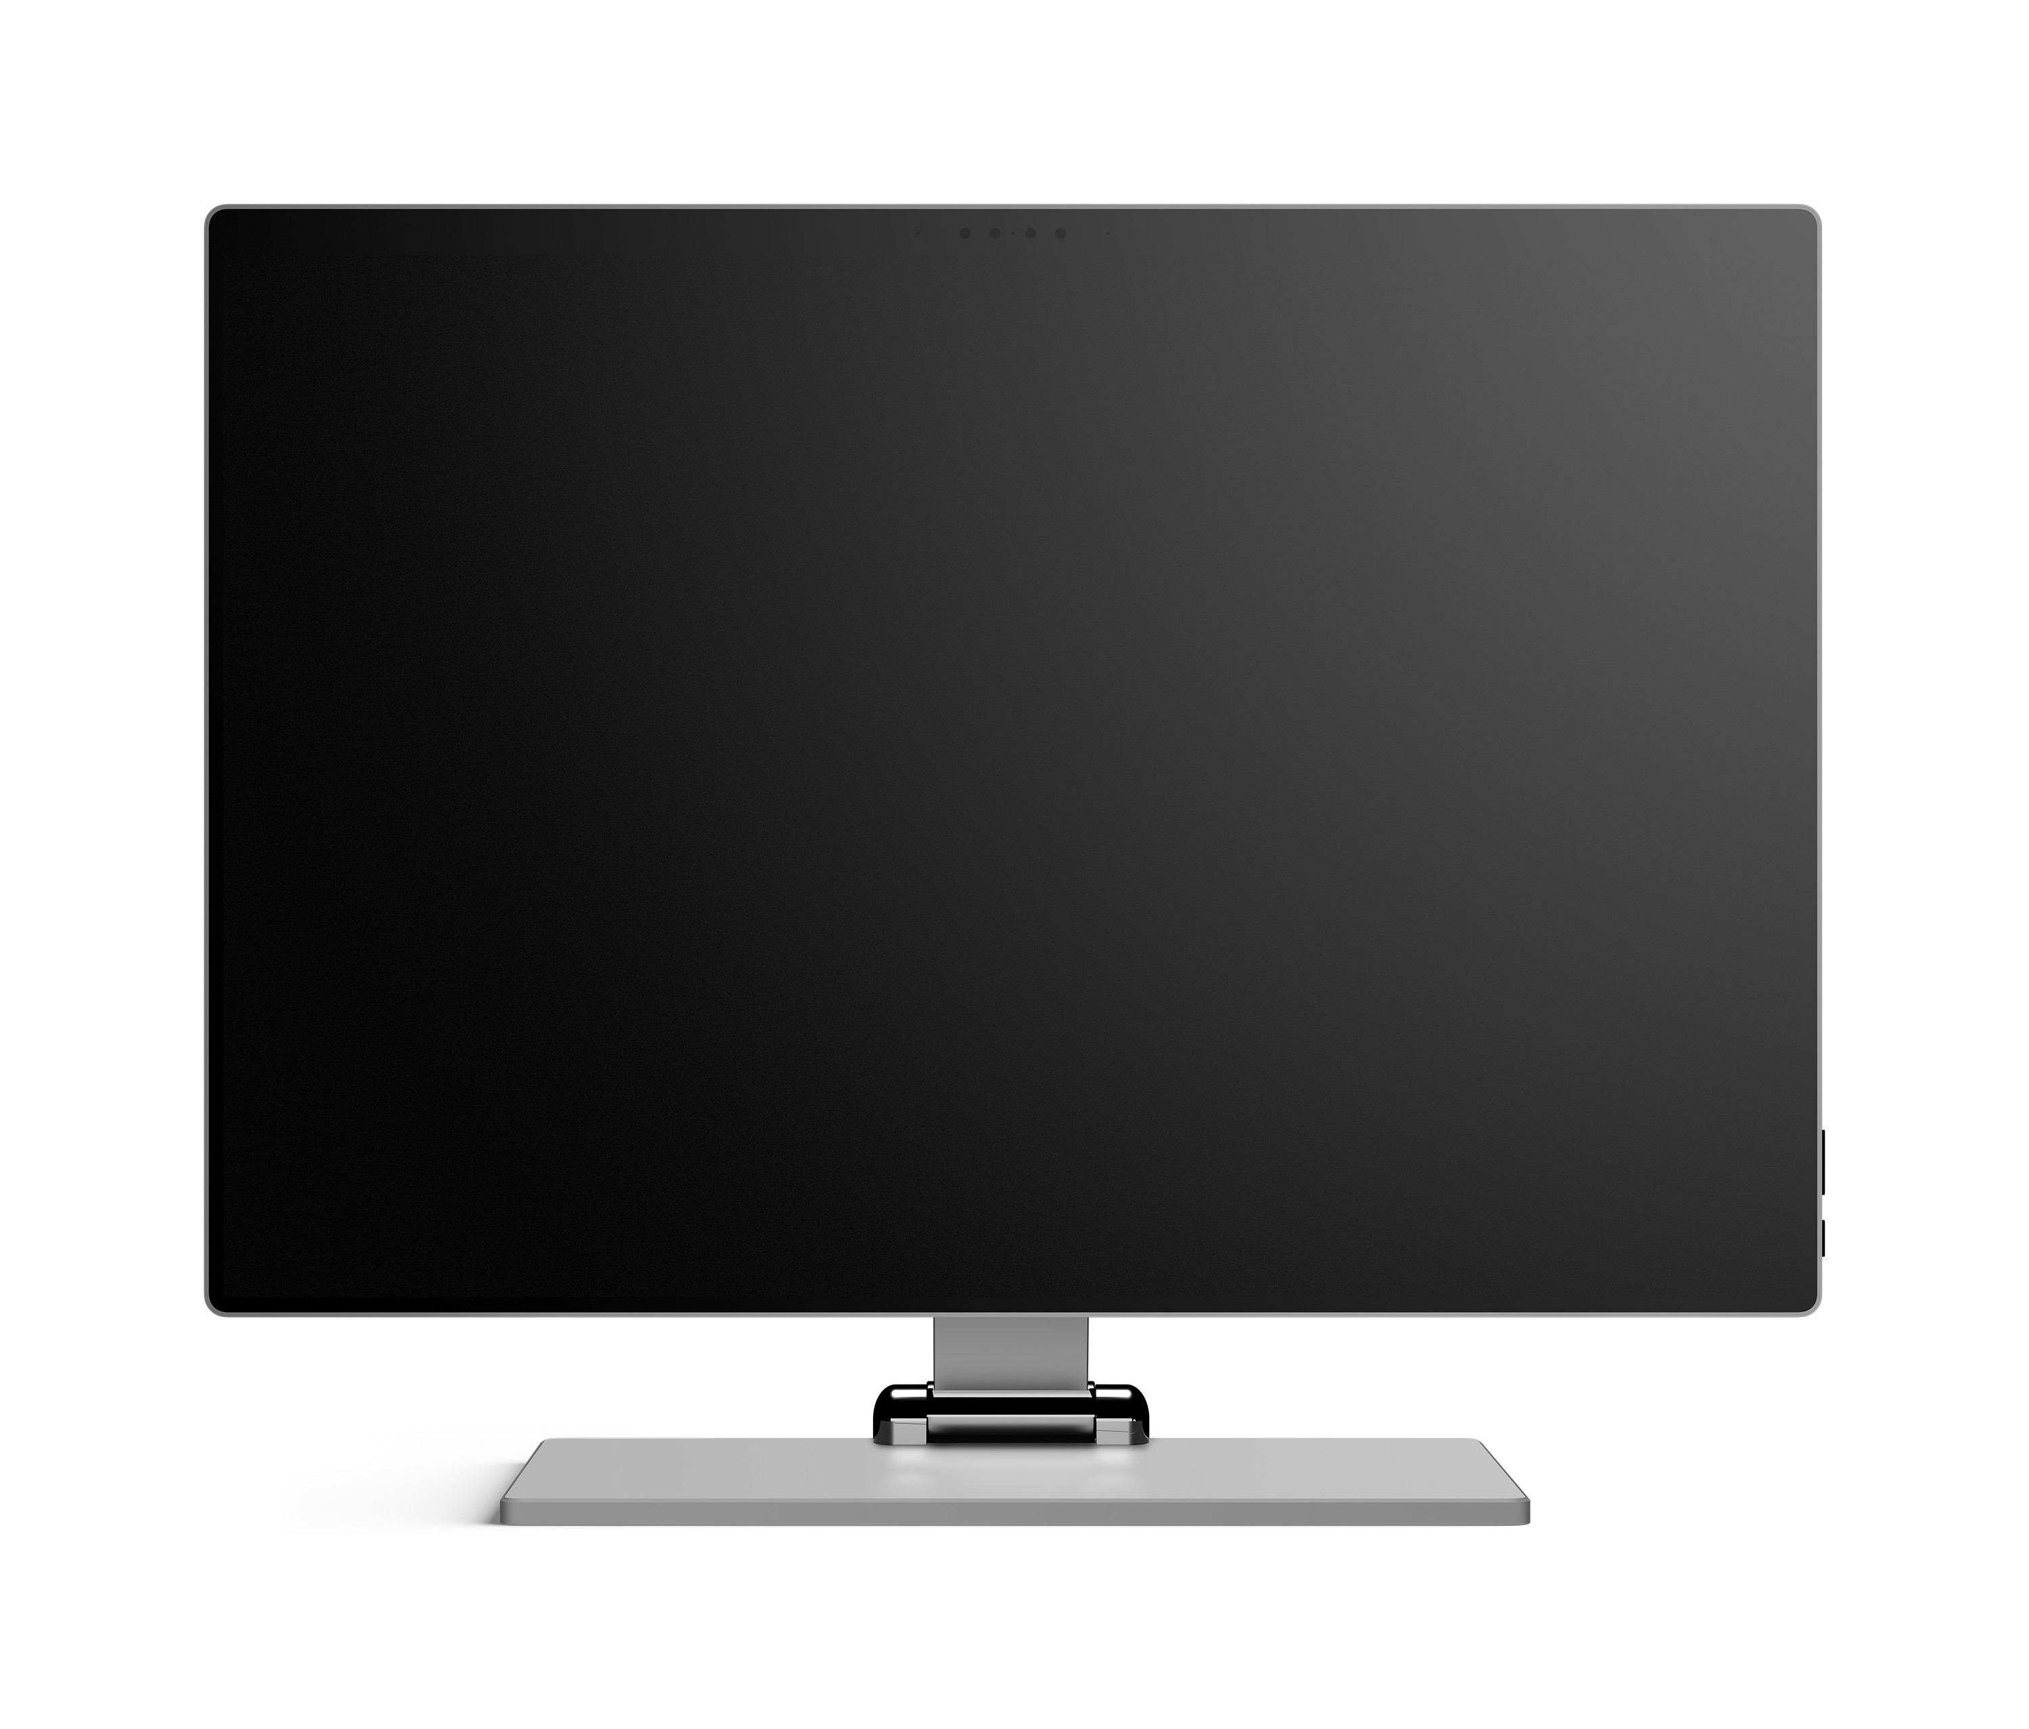
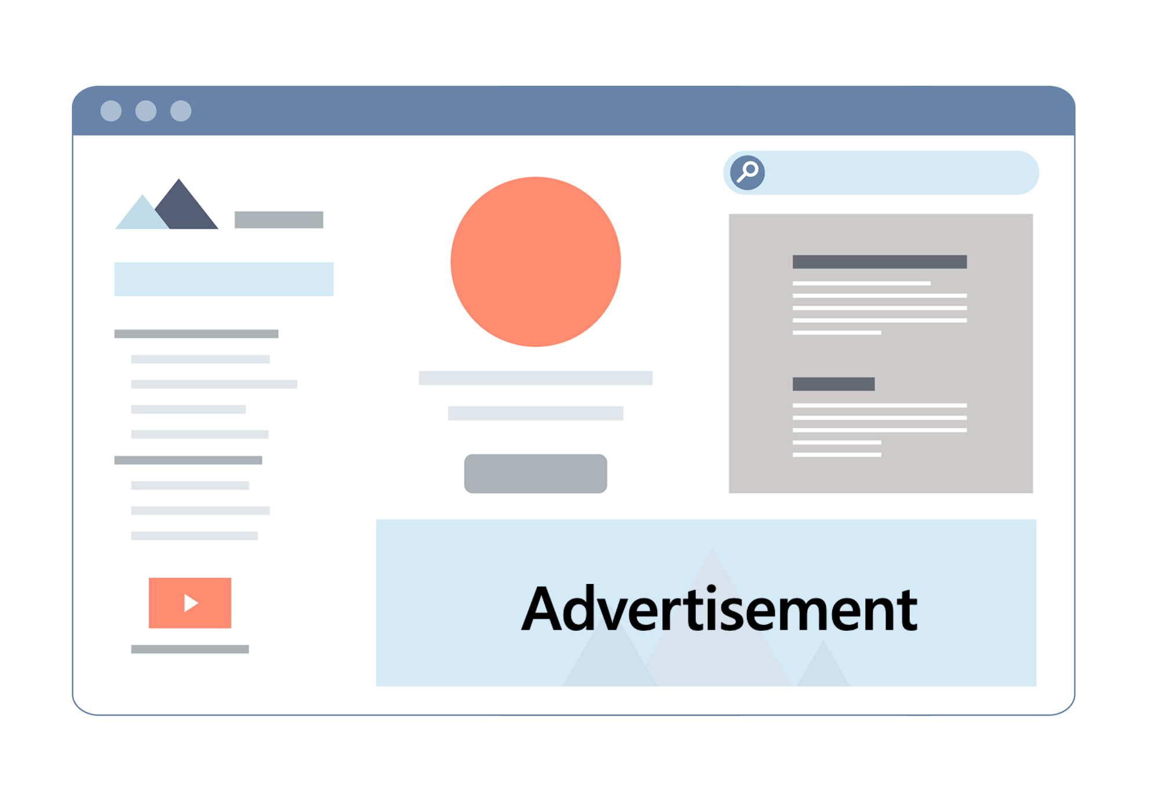
WebView

Slide 8
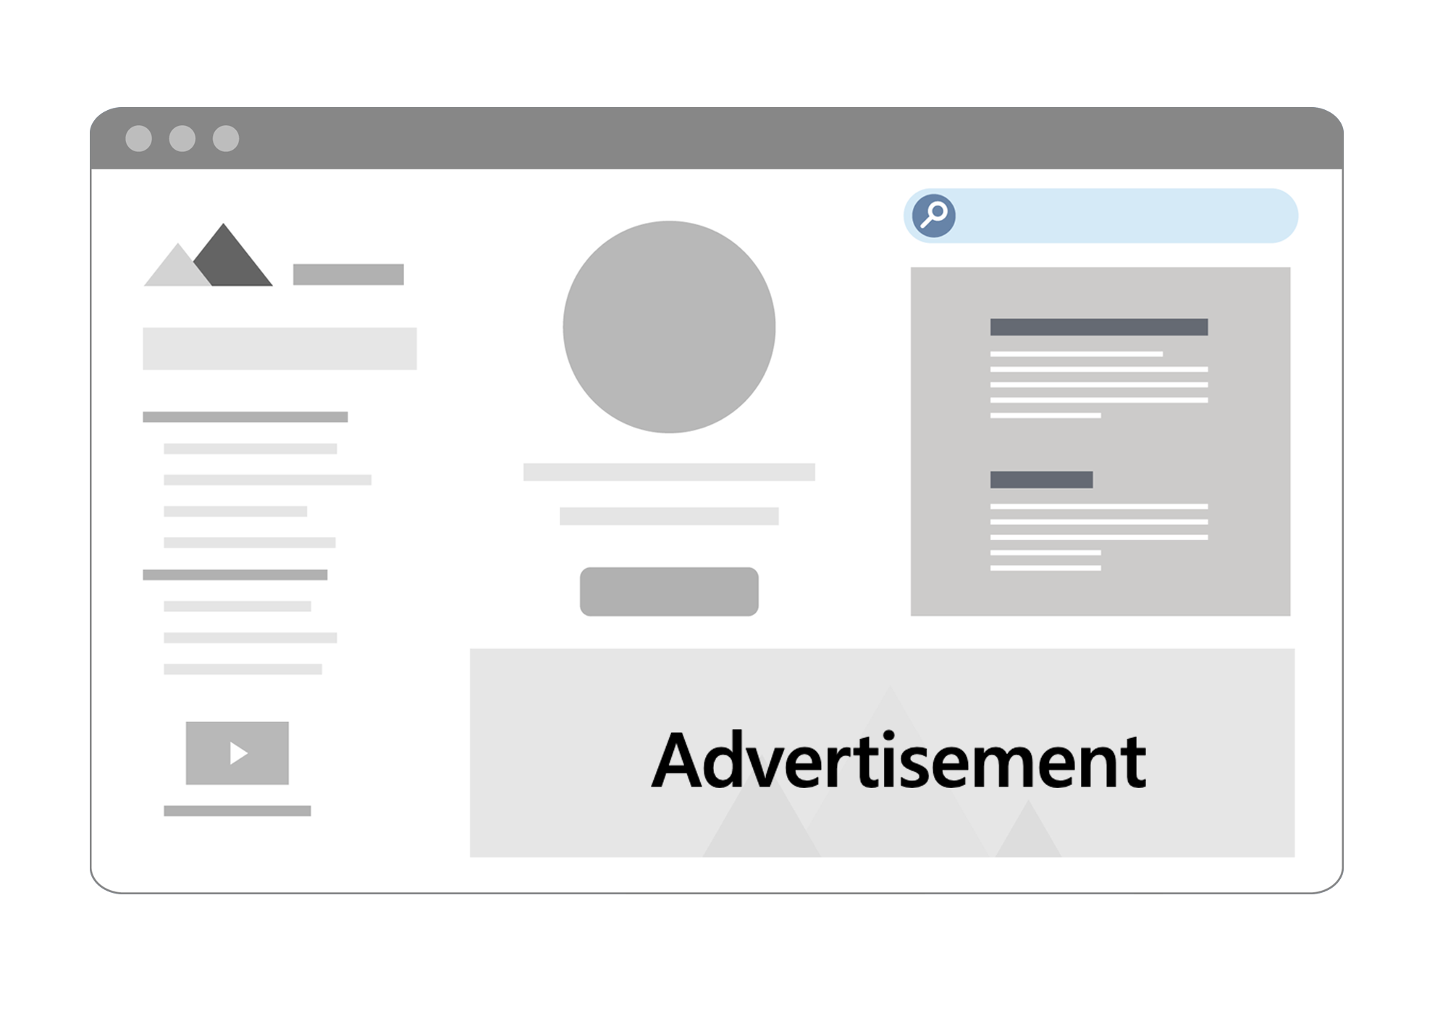
WebView
Agenda
WebView

Slide 9
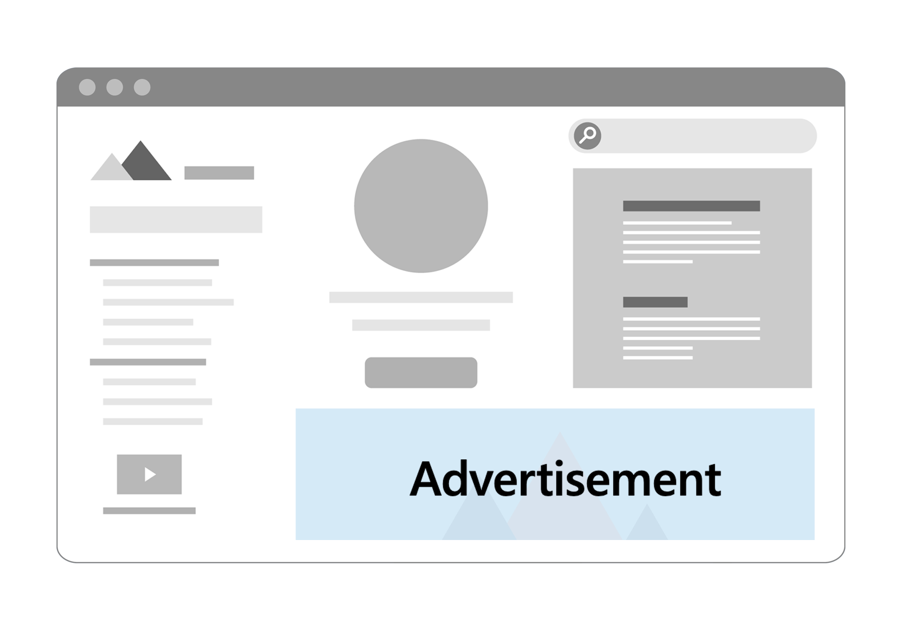
WebView
Agenda
WebView

Slide 10
WebView
WebView
Agenda

Slide 11


Legacy Controls on Windows
WebBrowser control
Based on MSHTML (IE)
Supported across Windows
EdgeHTML WebView
Based on EdgeHTML
Limited availability on Win10
Inconsistent across OS versions

Slide 12




WebView2
Microsoft Edge (Chromium) Platform
Consistent across supported Windows versions
Available for Win32, WinForms/WPF, WinUI 3.0 (Preview)
Does not require Microsoft Edge Browser

Slide 13
WebView2 Runtime
1 | 2 | 3 | 4
Redistributable runtime; not a user visible browser | Microsoft Edge binaries tuned/tested for app usage | One single copy will power all evergreen apps | Install/Update can be managed through policies
aka.ms/webview2

Slide 14

Distributing WebView2 Applications
WebView2 Runtime | Disk Footprint | Update Model | Compatibility Testing
On the box | Minimal | Automatic | Continuous
Packaged with application | Higher | Manual | Own Preference
Evergreen
or
Fixed version

Slide 15

WebView2 is GA 🎉
UI Frameworks: Windows Forms WPF .NET Versions: .NET Framework 4.6.2+ .NET Core 3.1+ .NET 5 Distribution Modes: Evergreen Fixed Version
aka.ms/webviewfeedback

Slide 16
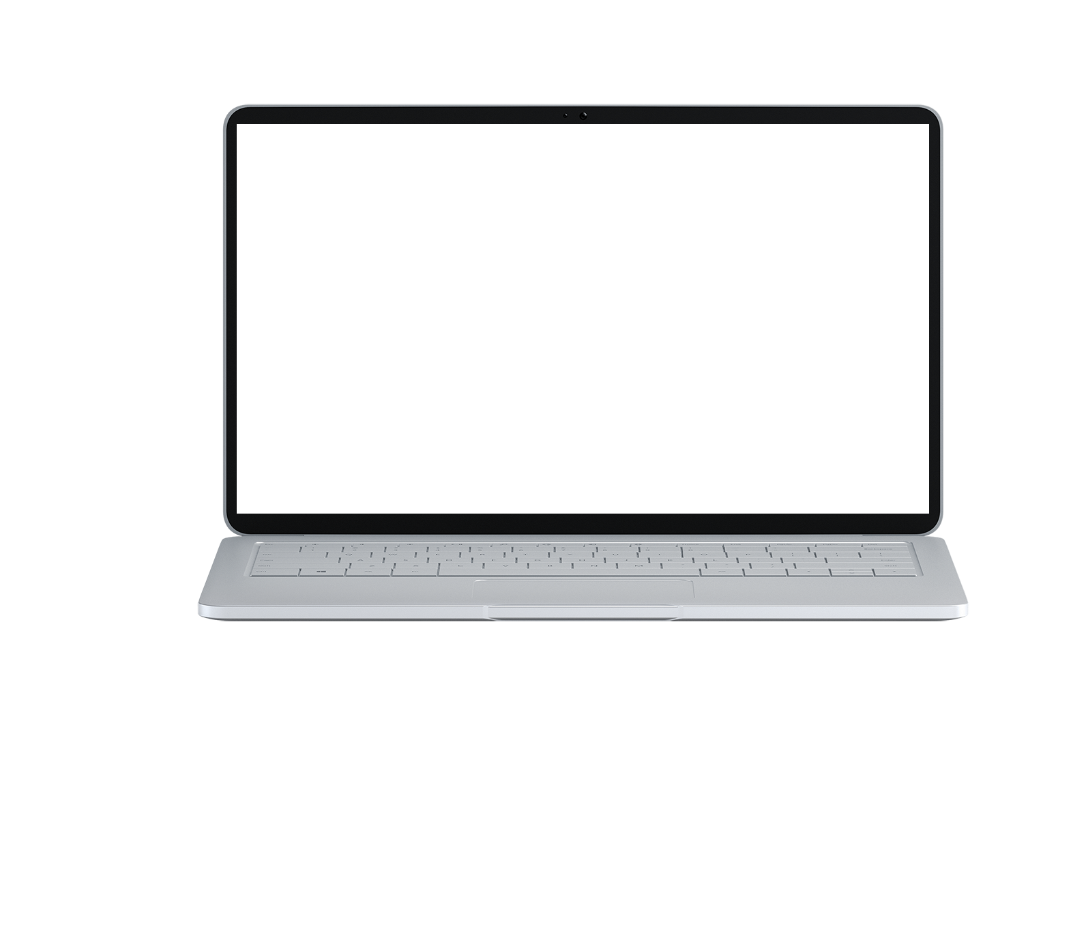
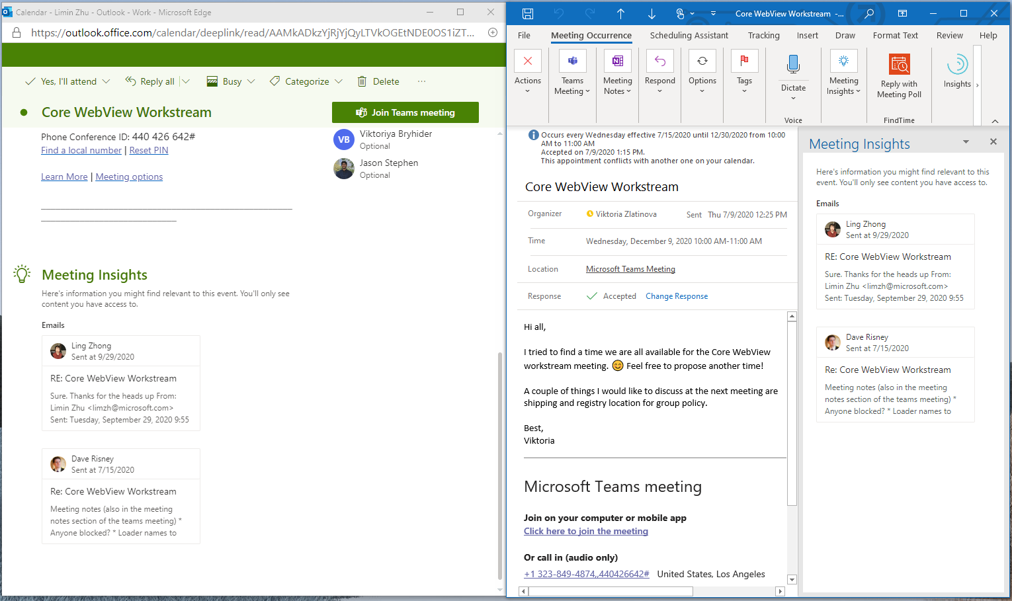
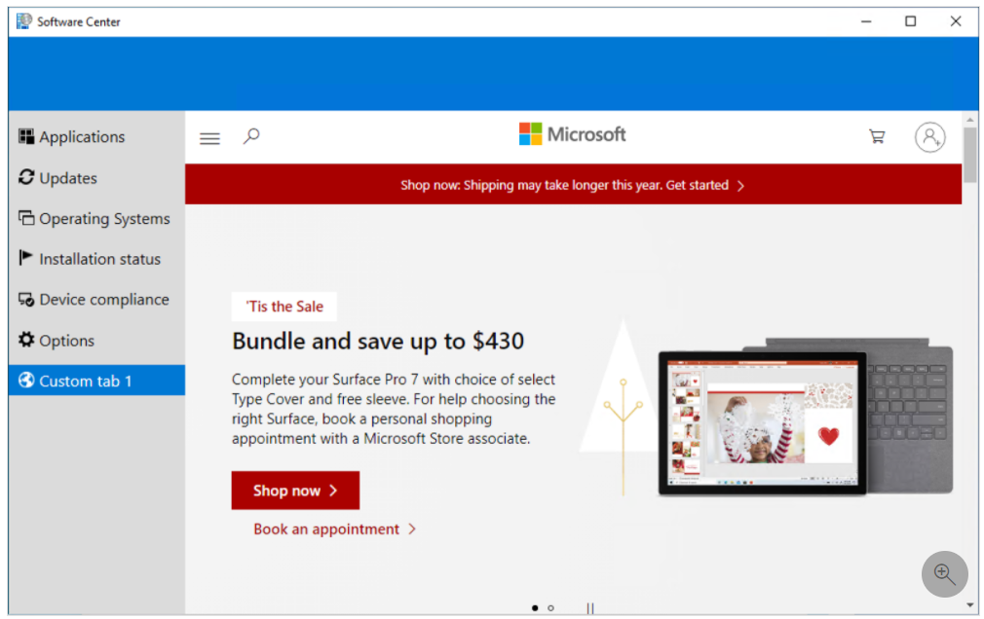
Microsoft Case Studies
Building WebView2 Applications

Slide 17
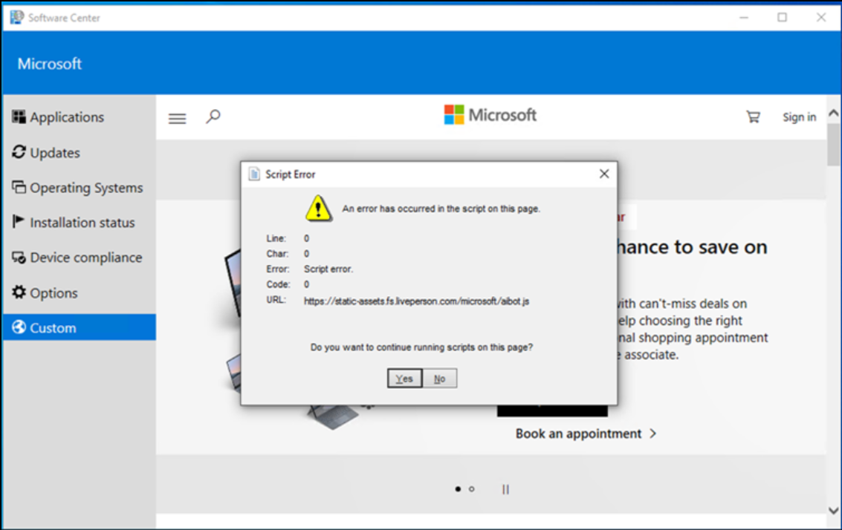
ConfigMgr – Custom Tabs
Before | After

Slide 18
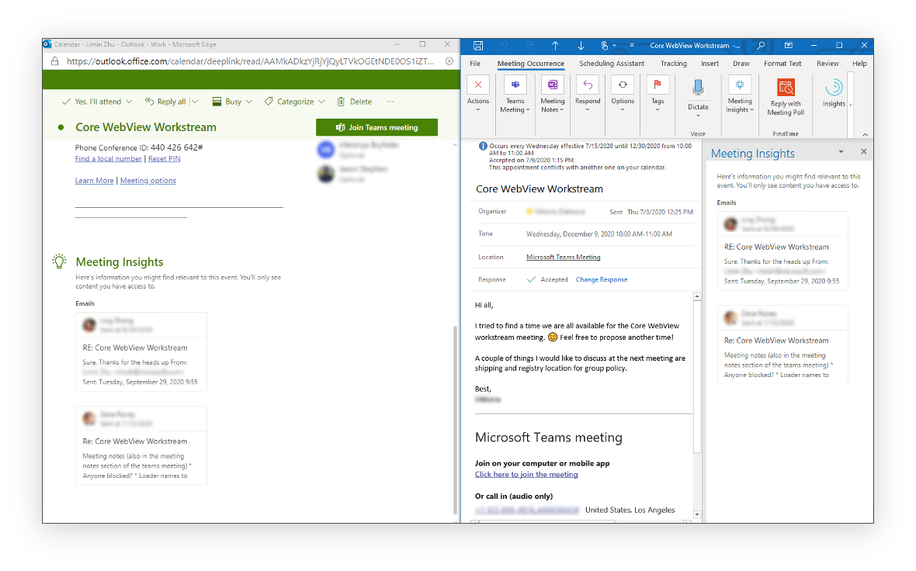
Microsoft Outlook – Meeting Insights

Slide 19
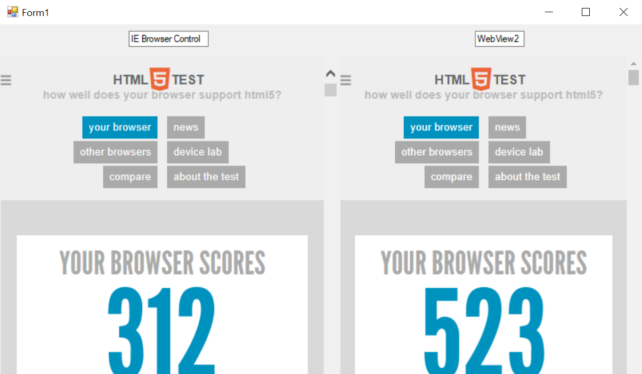
Demo
WebView2 in WinForms
aka.ms/webview2

Slide 20

Roadmap
What’s Next with WebView2
aka.ms/webview2

Slide 21



Whats Next with WebView2?
Improving WebView2 Runtime Availability
.NET 6 Support
Responding to Feedback
aka.ms/webview2

Slide 22
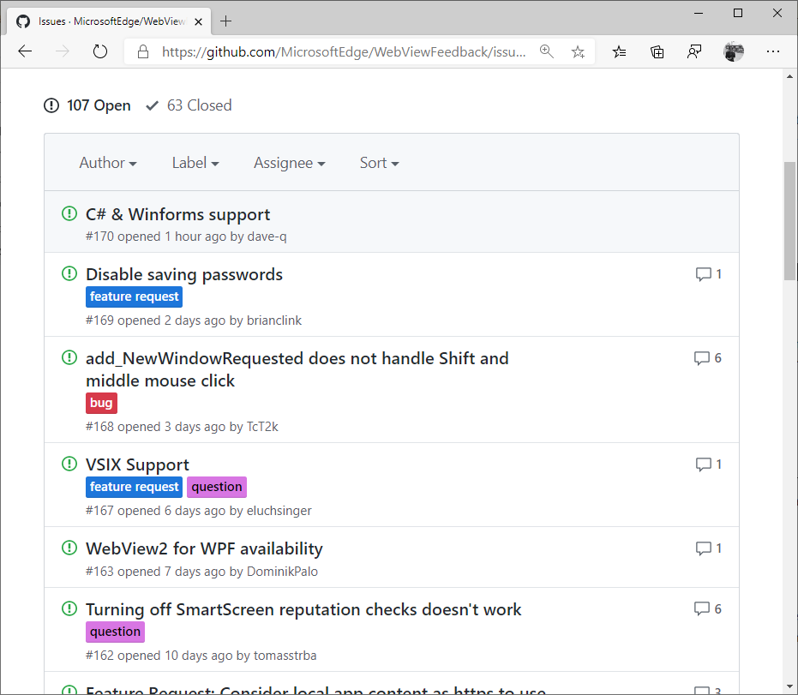

Your voice matters
aka.ms/webviewfeedback

Slide 23
Recap
WebView2 is GA .NET Developers
Start building and deploying WebView2 applications
Share your feedback to help us build WebView2
aka.ms/webview2

Slide 24
Call to action
Get started
aka.ms/webview2
INSERT RIGHT ARROW ICON
Learn more about WebView2
WebView2 Runtime
aka.ms/wvrt
Enterprise management
aka.ms/webview2Ent
Share your feedback - aka.ms/webviewfeedback
aka.ms/webview2

Slide 25

Thank you

